Slide 1
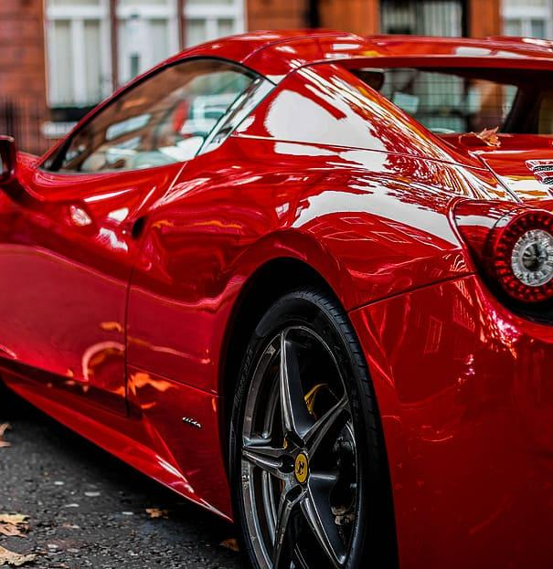
NEO4J
Application In Hyper Luxury
“
DSO 553
Group 3

Slide 2
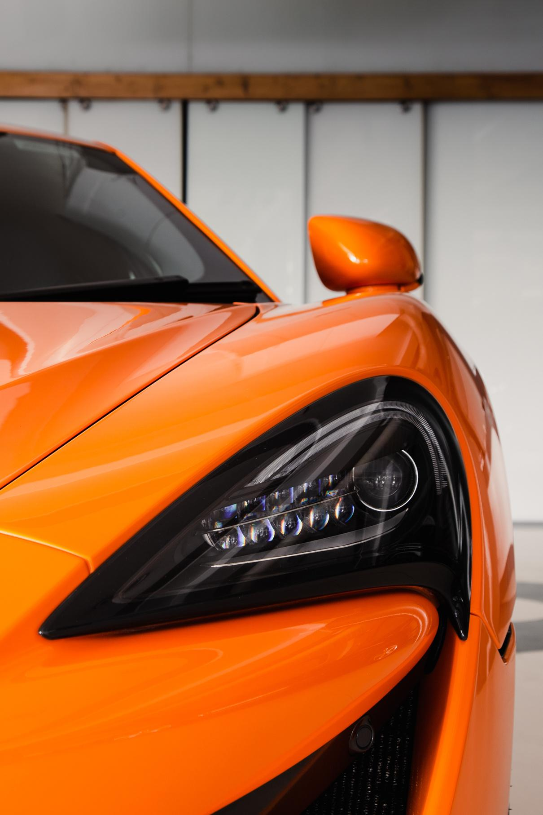
BUSINESS
BACKGROUND
Industry: Hyper Luxury Market
Company: Hyper car startups
Target customer: High Net Worth Individuals
Business Pain point:
Not sure how to promote
Need of precision marketing
Understand personal relationships as a source of information to penetrate celebrity demographics
Avg USD 2,000,000+
Notes:
Knowledge graph focuses on connections and after assessing various industries, we decided to proceed with hyper luxury market as it’s a market that can heavily reply on network.
Currently, in this domain, we have these pain point…
And by focusing on analyzing

Slide 3
Data Collection
Tool: Social Network Graph
Study Object: Celebrities Social Network (Accessibility, sustainability)
NET WORTH | Estimated Net worth presenting their financial condition
GENDER | Potentially shows preference/attitude
CAREER | Foundations of connection
LOCATIONS | Geographic proximity promotes time spent and enhance relationships
ETHNICITY | shares cultural background and experience
NATIONALITY | shares cultural background and experience
FAMILIARITY SCORE | Based on criteria 0-0.3, 0.31-0.6, 0.61-1.0 *0-0.3 for casual acquaintances with sparse interactions, 0.31-0.6 for moderate acquaintances with frequent collaborations; and 0.61-1 for close personal relationships with regular, significant engagements.
Notes:
We chose specifically celebrities as the demographics for ultra rich people because their relationship connections information are available for us to collect

Slide 4
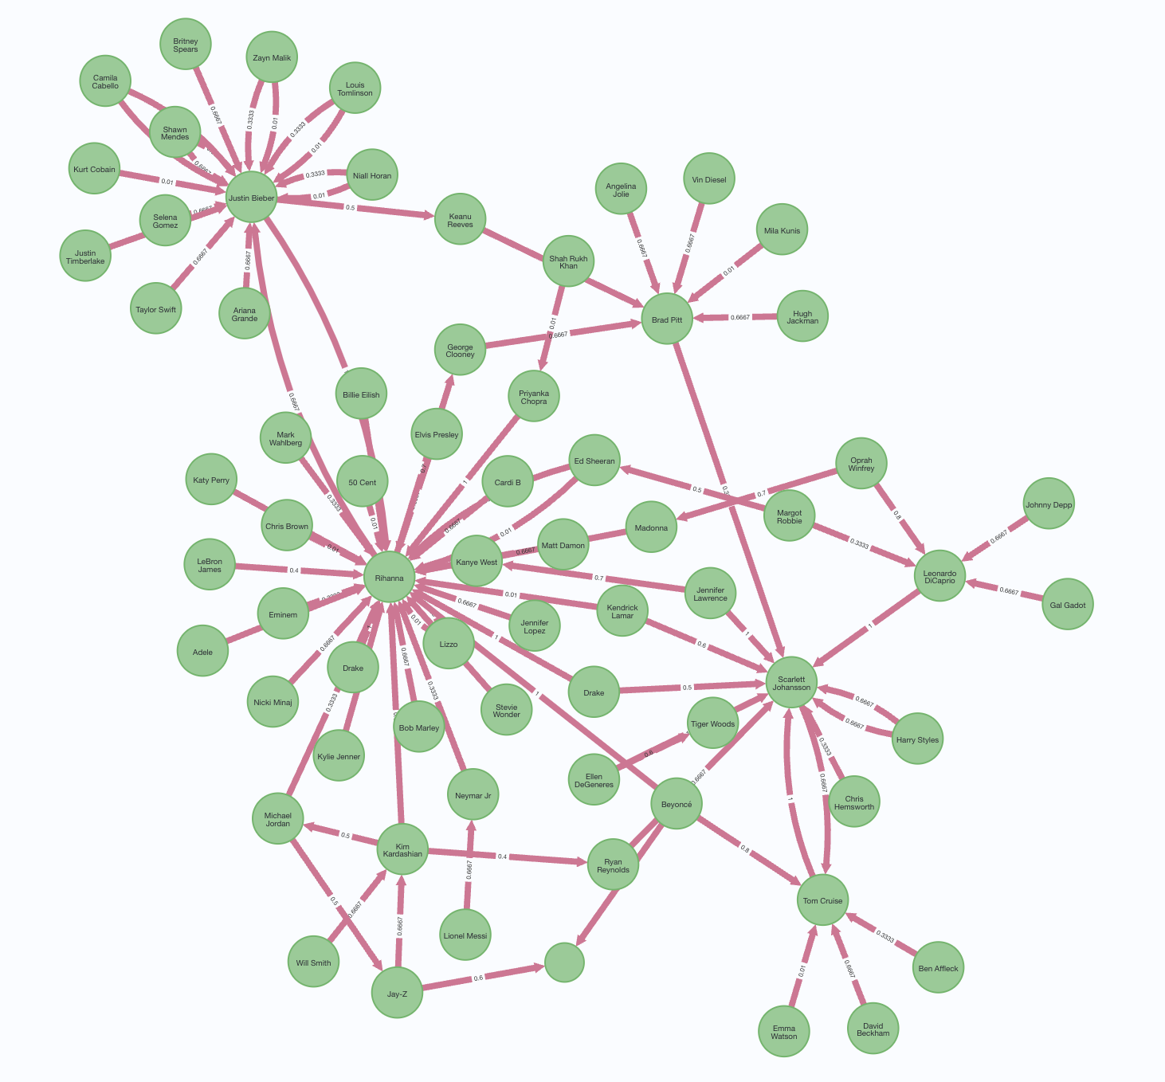
Knowledge Graph
FAMILIARITY SCORE | Based on criteria 0-0.3, 0.31-0.6, 0.61-0.1 *0-0.3 for casual acquaintances with sparse interactions, 0.31-0.6 for moderate acquaintances with frequent collaborations; and 0.61-1 for close personal relationships with regular, significant engagements.

Slide 5
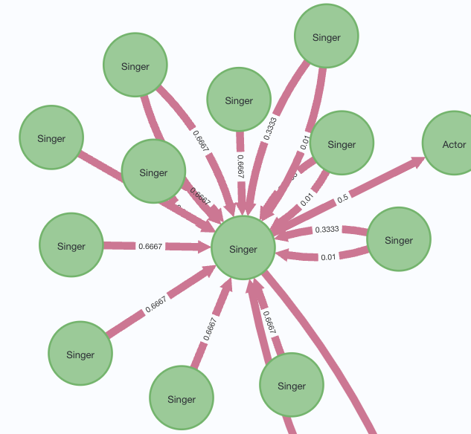
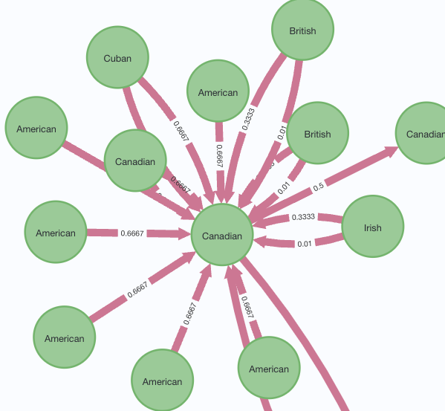
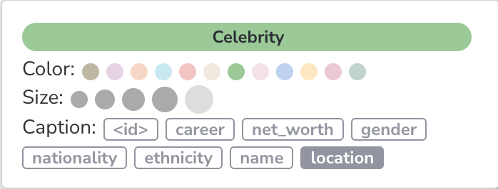
Business Question 1
Which community should business target and penetrate?
Find the most condense social circle (community detection)
Discover potential community by checking if they have the same attributes value (similarity)
Career attribute
Nationality attribute
Notes:
Business significance:

Slide 6
Business Question 2
Who is the key influencer, what would be best outreaching path?
0.01
By looking at the most dense network connection, we can easily identify the key influencers (centrality)
By calculating the familiarly score, we can identify the shortest & most effective outreaching path
(path finding)
Common misconceptions:
Short is not always better
50 cent vs Tom Cruise -> Rihanna
More outreaching paths are not always better
Evaluated with the total familiarity score
1
0.8

Slide 7
Limitation and further analysis
The End
THANK YOU
Limitations
Relationship can be subjective
Source of information need to be credible
Higher precision in familiarity score yields to better business applications however it’s difficult to quantify

